Slide 1


The Tech Domino Effect: Volatility Transmission from Mega-Caps to the S&P 500
Vo Thi Quynh Tram, Lai Chiu Lok, Huei-Wen Teng
https://www.overleaf.com/project/68c75b0aa8f3648d0d354604
20251012 Linear Regession

Slide 2

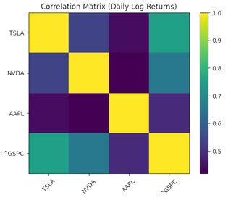
Motivation
Motivation
⊡ Rising dominance of mega-cap tech firms in the market.
⊡ Potential volatility spillovers affecting overall market movements.
⊡ Need to assess systemic risk from concentrated market influence.
Linear Regession

Slide 3

Outline
Motivation
Data
Multiple Linear Regression
Results
Conclusion
Linear Regession

Slide 4
Data
Data Preprocess_Data Overview
Period: 2015–2024 (Daily)
Source: Yahoo Finance (Adjusted Close)
Assets analyzed:
Apple (AAPL)
Nvidia (NVDA)
Tesla (TSLA)
S&P 500 (Benchmark)
Transformation: Log returns → Rolling Volatility (annualized)
Linear Regession

Slide 5
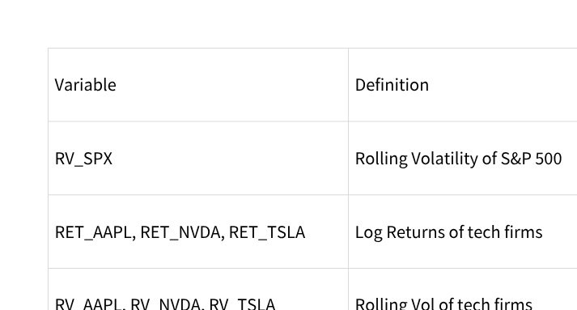
Data
Data Preprocess_Variables
Linear Regession

Slide 6
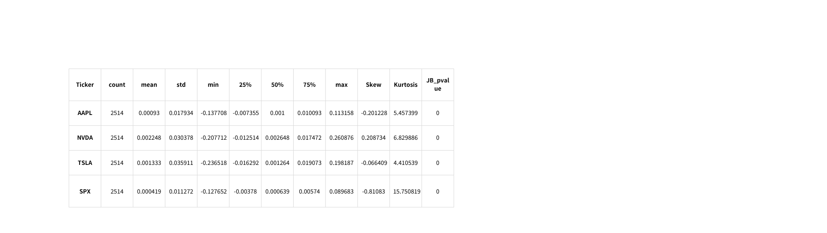
Data
Data Preprocess_Descriptive Statistics
All assets: Mean ≈ 0, high variance (Std highest for TSLA)
Evidence of non-normality:
Positive/negative skew → asymmetric risk
High kurtosis → heavy tails
JB-test → rejects normality (p = 0)
Linear Regession

Slide 7
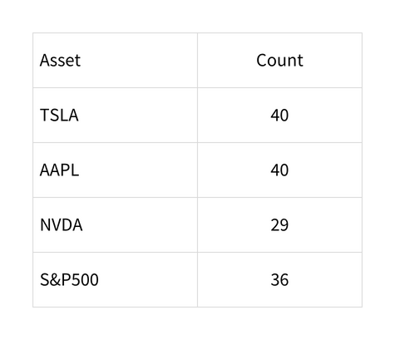
Data
Data Preprocess_Extreme Events (|z| > 3)
TSLA & AAPL most prone to tail shocks → candidates for volatility domino effects.
Linear Regession

Slide 8
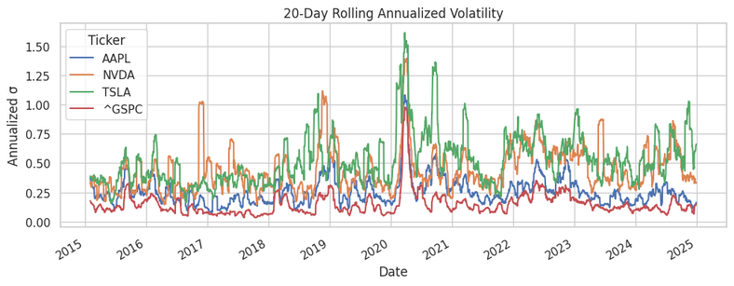
Data
Data Preprocess_Rolling Volatility
TSLA & NVDA show sharp volatility spikes (2020–2021)
SPX volatility rises after mega-cap spikes → Possible contagion
AAPL = moderate, smoothed volatility (market stabilizer)
Linear Regession

Slide 9
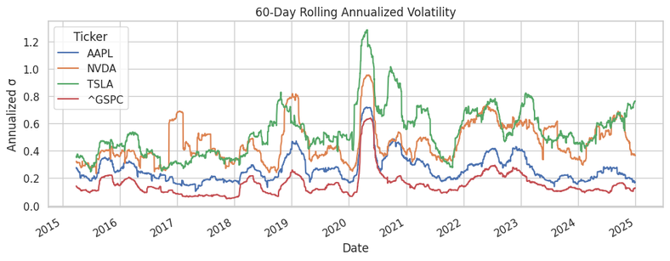
Data
Data Preprocess_Rolling Volatility
TSLA & NVDA show sharp volatility spikes (2020–2021)
SPX volatility rises after mega-cap spikes → Possible contagion
AAPL = moderate, smoothed volatility (market stabilizer)
Linear Regession

Slide 10
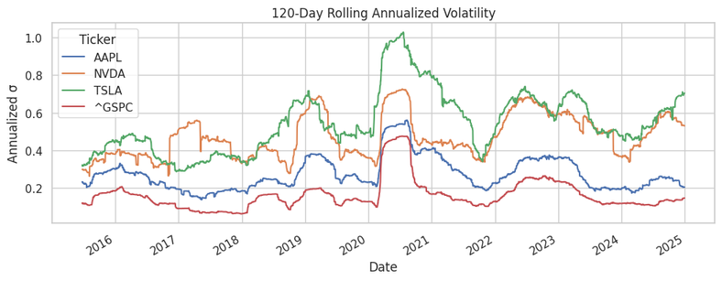
Data
Data Preprocess_Rolling Volatility
TSLA & NVDA show sharp volatility spikes (2020–2021)
SPX volatility rises after mega-cap spikes → Possible contagion
AAPL = moderate, smoothed volatility (market stabilizer)
Linear Regession

Slide 11
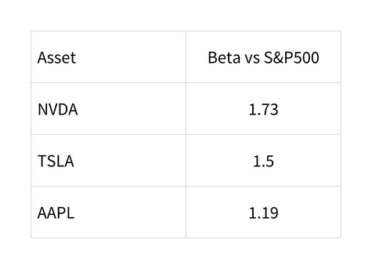
Data
Data Preprocess_Market Sensitivity
NVDA & TSLA amplify market risk (“leveraged exposure”)
High Beta supports volatility transmission hypothesis
Linear Regession

Slide 12
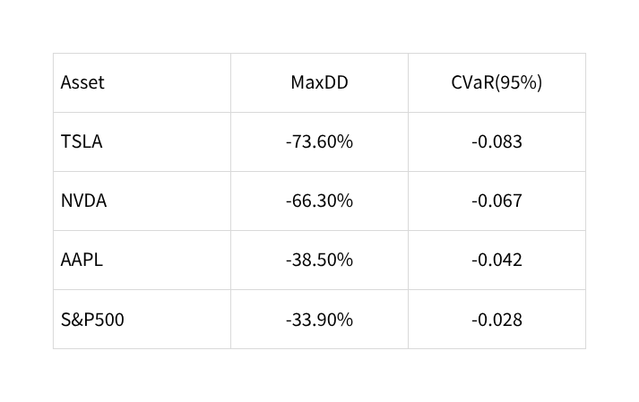
Data
Data Preprocess_Risk Metrics (MaxDD,CVaR)
Mega-caps have deeper crash risk → Potential systemic propagation.
Linear Regession

Slide 13
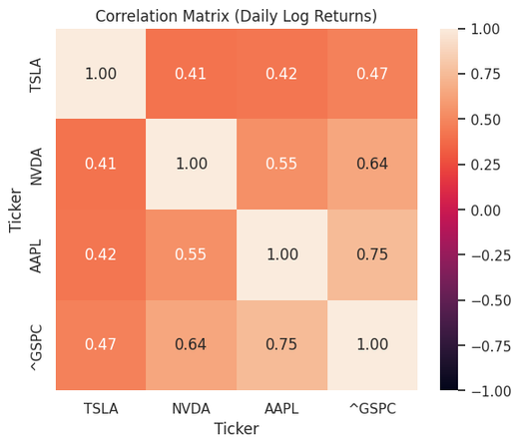
Data
Data Preprocess_Correlation & Co-Movement
AAPL highly correlated with SPX (~0.75)
TSLA shows episodic decoupling (idiosyncratic risk)
NVDA moderately correlated, rising in AI boom
Conclusion: Strong integration but not perfect coupling → transmission, not redundancy.
Linear Regession

Slide 14
Data
Data Preprocess_Key Findings (Volatility Transmission)
Evidence of fat tails, extreme risk, and high Beta in mega-caps
S&P500 volatility spikes lag mega-cap volatility surges
Tech sector acts as a volatility leader, not follower
Linear Regession

